Slide 1

WorkIt: Lifestyle and Time Management for Students
Phase Three: Evaluation
Presented by: Abdilgani Abdallah M00491564, Wisam Albarkat M00493452, Mohamed Saeed M00530883,
Sebastian Zdroana M00495434
Middlesex University | Computer Science | Human Factors in design
Notes:
Hello guys , we are team workIT. today we will be presenting our evaulation for our WorkIt time management and lifestyle application.

Slide 2

Recap
Research
Questioners
Interviews
Design
Conceptual design
Balsamiq Mock-up
Notes:
Lets first start with a recap of the previous phase, in the first phase We conducted interviews and questioners to gather valuable data to analyze and understand users needs. Then Use the analyzed data to help aid in the design of our time management application.
Second phase was based on the information retrieved from the initial research phase.
we first carrioud out different design methods such as sketches, design diagrams ( for example concept diagrams and user journeys), moreover, as a group we created few storyboards and scenarios to come up with visual and textual stories for the potential users of the application. Then Based on the design methods and diagrams we created the Mybalsmiq mockup.

Slide 3

User Testing
Setup
Recordings
Purpose of testing is conveyed to participants
Notes taken by test conductors
Participation sheets & Signed consent forms
Notes:
We made sure that the setup is always carried out in the same way. We booked rooms in advance therefore rooms were available at the time of testing. Also, the environment had to be quite, and we made certain that the testing environment included the team and the participant only, for the reason of avoiding any influence from other people.
Our tests were video recorded and that was mentioned to the participant before the test, furthermore participation sheets and consent form were given to the participants for them to sign.
The purpose of this test was given to the participants to give them an idea of what to expect.
During the test, two of the team took notes. While the other two asked the participants questions.

Slide 4

Purpose of testing
Point out the defects and errors
Validate user needs
Verify if the application meets the stated requirement
Find out if the purpose of the features are understood by users on first impression
Verify if new ideas are fit for consumer level application
Improve the application further after user feedback
Notes:
1- Software testing is required to point out the defects and errors that were made during the development phases. It's essential since it makes sure of the Customer's reliability and their satisfaction in the application.
Developers can predict the users needs through the research stage of development but to validate the needs, testing is required.
Testing can also be used to verify if the created application has met the requirement set during early development stages.
Developers sometime forget that they are more knowledge than the average computer user, therefore some aspect of the application might seems easy to understand but to an average person it might be more challenging.
Moreover, new ideas can seem appropriate for an application on paper but not on a real life application, therefore to verify this, testing is used to check if the new ideas are fit for consumer level applications.
And of course testing can open the door for further improvements.

Slide 5

Target Audience
University students
Target Age
Randomly chosen
Exclusion of students from Computer Science or related courses
Notes:
we aimed to target students aged 18 and upwards as, they are more likely to require a time management application to manage their activities and studies.
The group asked the participants to take part in our research at random, therefore the gathered data are less likely to be biased to a different kind of group or people. And we intentionally excluded students from computer science or related courses.

Slide 6

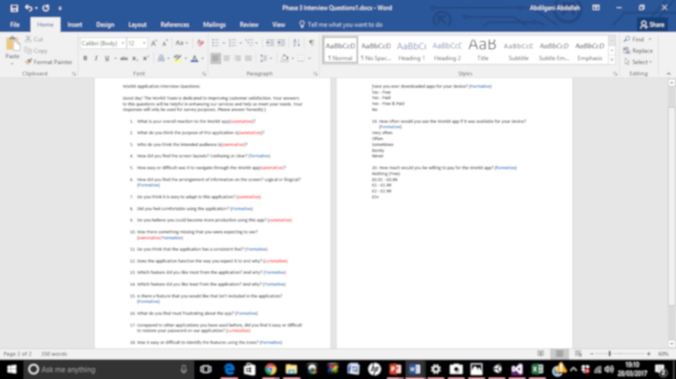
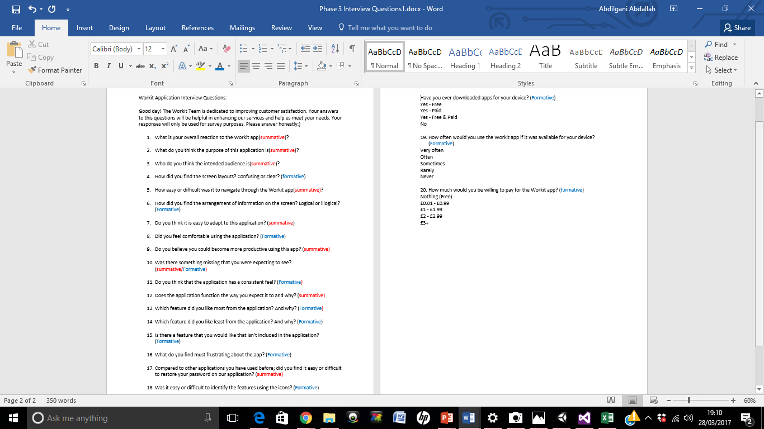
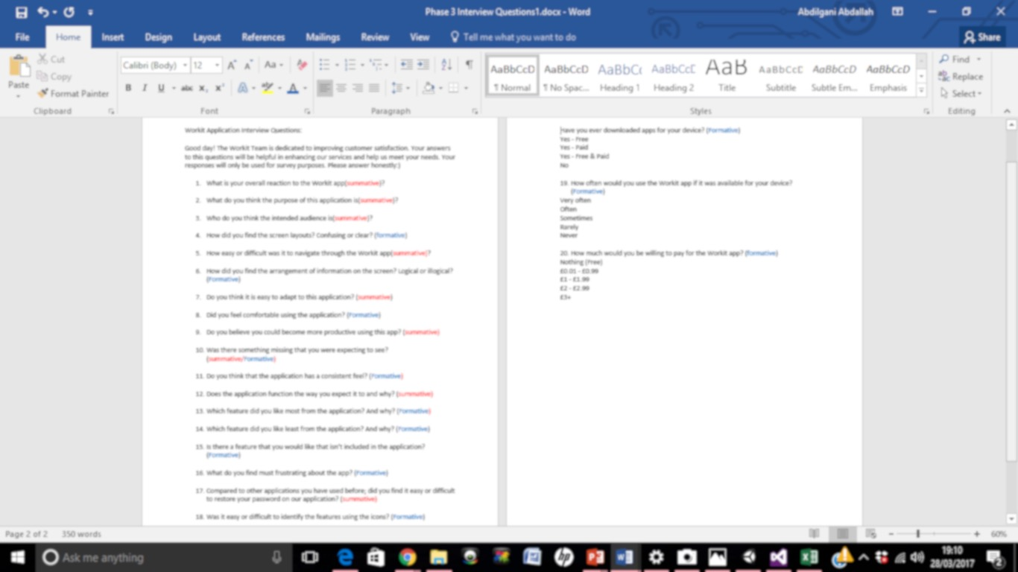
Formative & summative Evaluation
We labeled each question to detect the answers being either summative or formative.
Summative questions helped us check if requirements were met.
Formative questions helped point out the areas that needs improvement.
Notes:
To help us gauge whether the tester will provide a summative or formative answers, we labeled each question, therefore it is easier to analyse. Summative answers helped us check if the standard and requirements are met, for example, the question “do you think it is easy to adapt to this application” is a summative question, and likely will provide an answer of a yes or no which then will help us to check if we met the requirement of having an easy to adapt to application.
On the other hand, Formative questions are where answers are expected to point out potential improvements, for example, the question “which feature did you like least from the application? And why?” will provide answers that will highlight the application features that the users liked the least and in theory provide us the reasons why.

Slide 7

Self-Evaluation
Developers perspective
Identify possible improvement
Use our findings to cross check the outcome of the user’s testing
Helps rise expectation
Allowed us see our work on a wider context
Notes:
Before we carried out the user testing we self evaluated our application
1- self evaluation helped us to identify the limitation of our application from our perspective as developers and designers, this identified things that non application developers wouldn’t be aware of
2- certain things were highlighted from the self evaluation that can be added to the application. we did this by reviewing all the features of the application as a group
3- using the outcome of the self evolution and the outcome of the user’s evaluation was a helpful process to have a bit of reassurance or guarantee of how we conclude our findings (to check if there are any consensus or if there are similar issues that are highlighted by us and the testing participants so you outcome becomes more meaningful)
4- in the sense that you will have certain expectations on issues that will be possibly raised
5- because experiencing the application with the mentality that you are a first time user, it opens up certain doors to see the application differently and find out things that you did not see as a developer initially

Slide 8

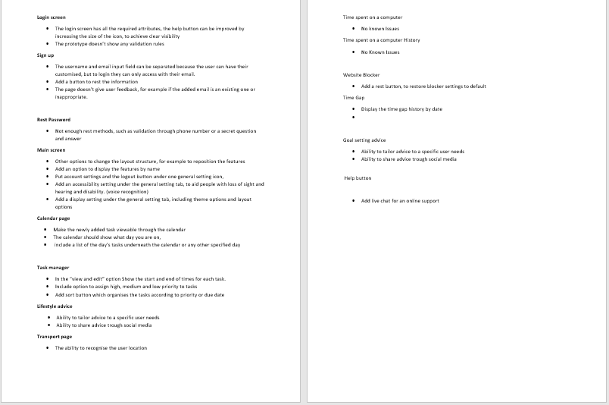
Self-Evaluation Document
Notes:
So this is the self evaluation document that we came up with, we have tested the app our selfs and we came up with a list of possible improvement for each feature highlighting ways in which we can improve our app
And this was eventually used in reference with the findings of the user testing

Slide 9
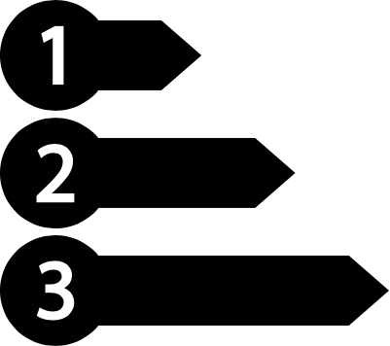
Different Testing Methods
Different data interpretation
Reduce the limitation of single method testing
brings diversity to the testing procedure
Methods we used are
Think aloud protocol
Timed usability test plan
Notes:
1- using the different methods was revealing because the idea was to see if the participants will come to the same conclusion even thought they have interacted with the application differently
2- it can sometimes be a pragmatic approach because it will essentially produce a biased outcome or a less diverse data or a one sided user experience or journey
3- the users will explore the application with less limitation compared to following the tasks we give them which a more controlled process

Slide 10

Think Aloud Protocol
User viewpoint based on the immediate user experience
Freedom to interact with the system without guidance
Minimises influence from the testing team
produce data that weren't thought off from the team
Can highlight areas that might have being left out during the usability test.
Notes:
1- the user’s feedback becomes more authentic because the information or the understanding they got is still fresh in their minds and therefore their feedback brings more meaning to table
2- this especially important because it in the real world people use apps without human instruction on how to use the app. So the think aloud protocol was important in this context because people can freely use the app and share their immediate thoughts
3- meaning we did not inform or handed the users instruction and it was more of a hands off approach (interact with the system and give us feedback as you go along)
4- because the users can
5- because things that we did not think about can arise in this process

Slide 11

Timed usability test
Follow a usability test plan (to do tasks)
User feedback
record completion of tasks & time
Errors made by the users
Comments by the test conductors
Notes:
1- We created a table with a list of to do tasks that the user has to complete one by one while we timed them
2-when they finish the process we tell them to gives a short feedback or remark before we carry on with remaining tasks
3- to see how long it took them to complete the tasks and if they completed the task how long did it take them to do so (because the completion time gives us a hint if the process is straight forward or if it can be simplified further)
4- errors were highlighted also to see if the users browsed through the app to find a particular feature
5- in the end of every task we took some notes to record how the process fell through as observers

Slide 12
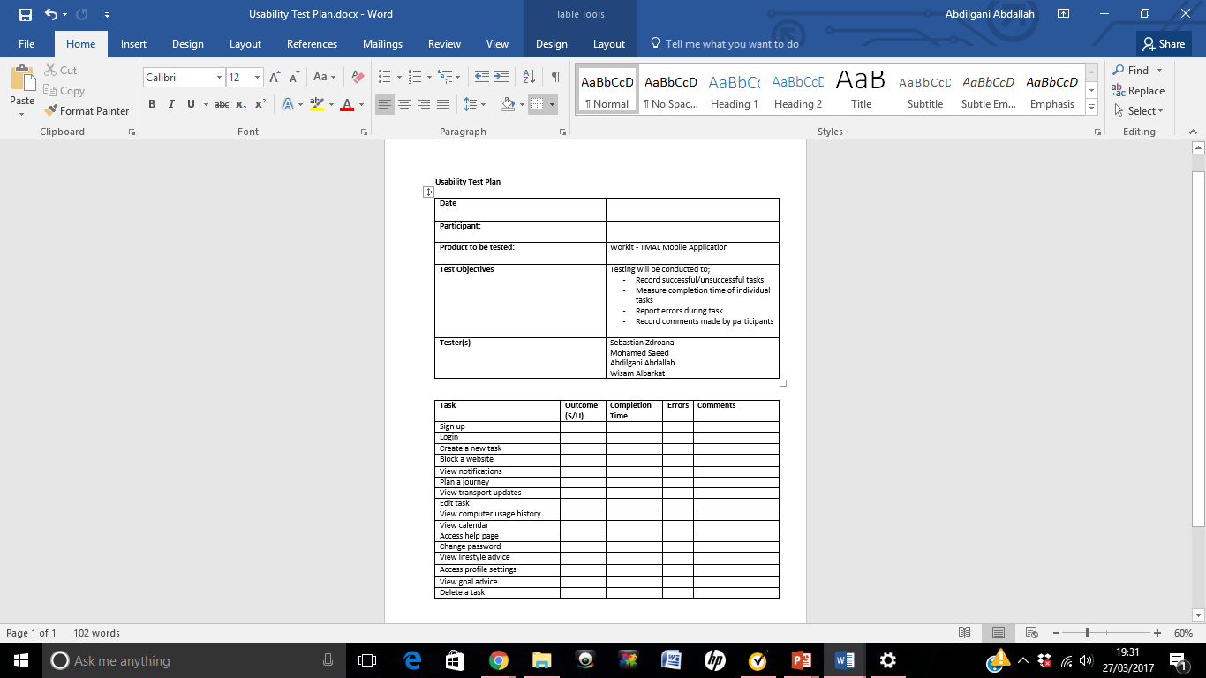
Usability testing plan

Slide 13

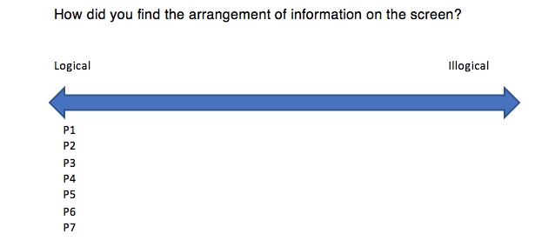
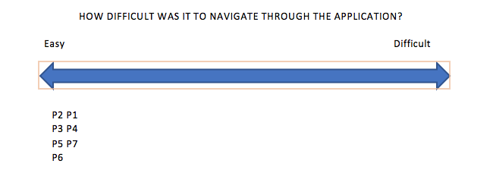
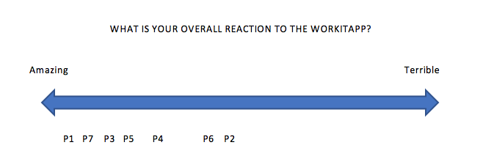
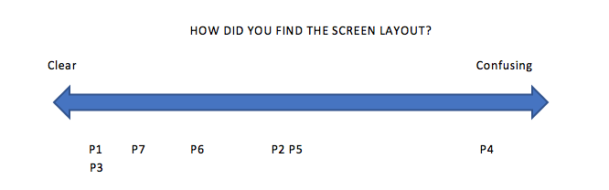
Variables
Notes:
This variables were used as a visual scale to understand the response of the interview questions and were users fit in that scale.

Slide 14
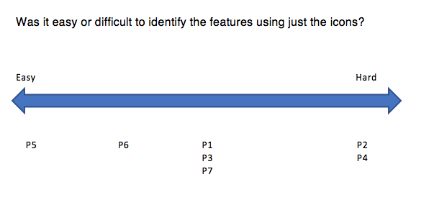
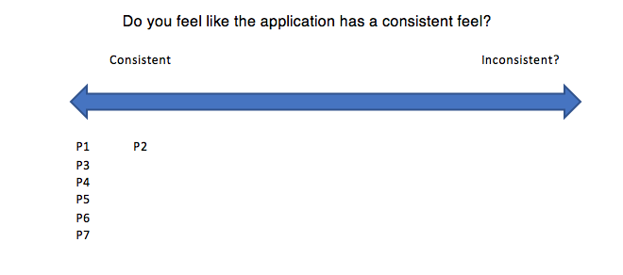
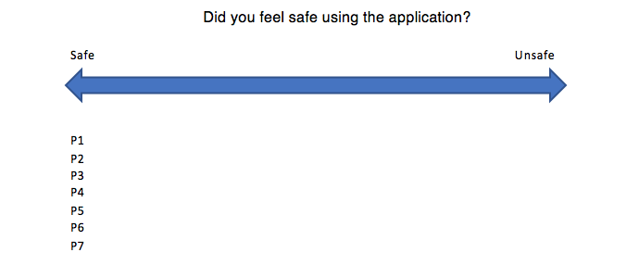
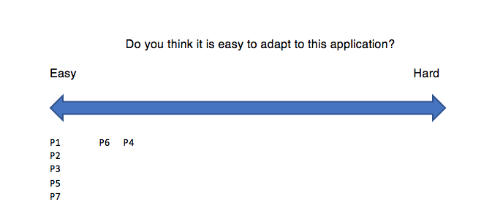
Variables

Slide 15

Post-Testing interview
User perspective
Positive, Negative and Constructive feedback
Both Audio and video Recorded
Have the functionality requirements been met?
Notes:
After getting the participants to perform activities with the application, we asked them to take part in an interview which would help us get useful information about the application from their perspective, positive, negative and constructive feedback.
We recorded the interviews both audio and video for further analysis, to replay what the users had to say about the application and to revise their reactions to certain questions. Because face expressions say more than words where someone may say they like something their face might make a different expression.
The data from the interviews helped us realise where the application had met the requirements set in the design phase, and where it didn’t. It also helped us to see if the aim of the application was clear enough to the user.
We then used an iterative data analysis method to break down and analyse the data, to transform it into useful information that we could use to finalise the prototype.

Slide 16
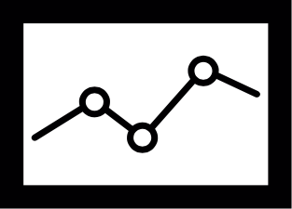
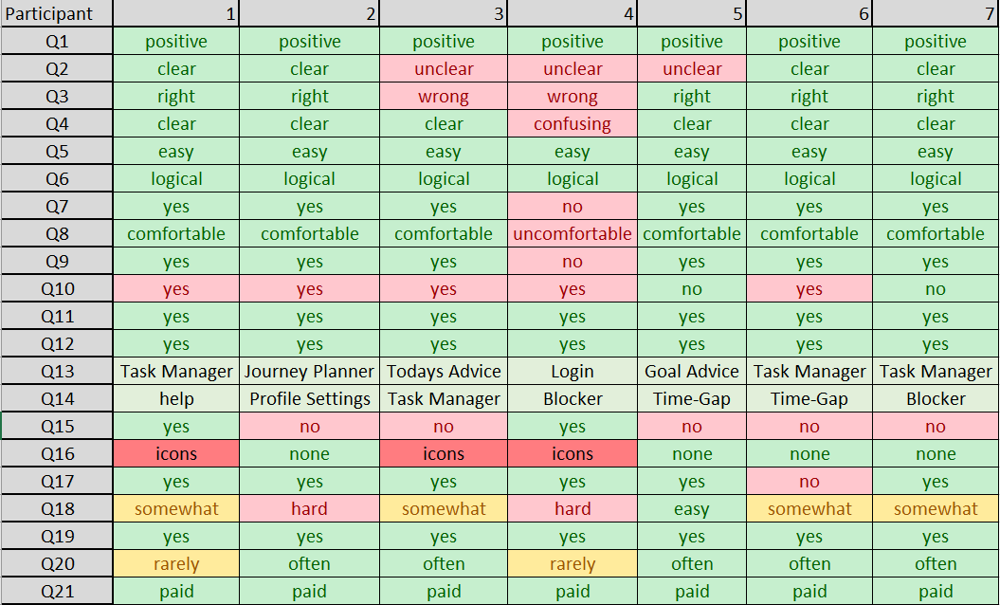
Statistics
Notes:
We analysed the interview data that we gathered by simplifying the answers that were given.
The columns are the participants answers.
While the rows are the question number answer.
So for example, for question 1 (Q1) all the participants answers were positive about their overall reaction to the application.
Whereas for question 2 (Q2) 4 participants stated that the target audience for the WorkIt application are students where 3 participants stated that the target audience for the application are others than students.
We did this because it then allowed us to create charts.

Slide 17
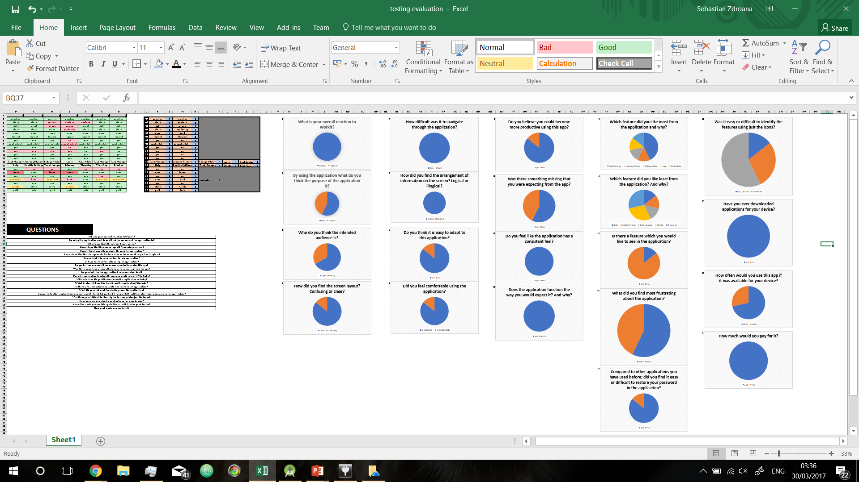
Statistics Cont.

Slide 18
Statistics Cont.
Notes:
Through creating pie charts we were then able to see percentages. You can’t see this from the screenshot as it would have crowded the slide too much. I’m not going to go through the pie charts as the next slide will cover the finalised information that we gathered through using this process of analysing.

Slide 19
Overall reaction: 100% positive, 0% negative
Application purpose: 57% clear, 43% unclear
Target audience: 67% clear, 33% unclear
Screen layout: 86% clear, 14% unclear
Navigating through the application: 100% easy, 0% hard
Arrangement of information on the screen: 100% logical, 0% illogical
Adapting to the application: 86% easy, 14% hard
Statistics Cont.

Slide 20
Comfortable using the application: 86% yes, 14% no
Help productivity: 84% yes, 14% no
Missing features: 57% yes, 43% no
Consistency: 100% consistent, 0% un-consistent
User functionality expectations met: 100% yes, 0% no
Favourite features: 43% Task Manager, 14% Journey Planner, 14% Todays Advice, 14% Login, 14% Goal Advice
Disliked features: 14% Help, 14% Profile Settings, 14% Task Manager, 29% Blocker, 29% Time-Gap
Statistics Cont.

Slide 21
Want more features: 86% yes, 14% no
Frustrating features: 43% icons, 57% none
Password recovery: 86% easy, 14% hard
Difficulty identifying features with the icons: 14% easy, 29% hard, 57% in-between
Participant has downloaded application on own device: 100% yes, 0% no
Application use: 71% often, 29% rarely
Pay to download WorkIt application: 100% pay, 0% free
Statistics Cont.

Slide 22

Post-Testing Interviews Outcome
Contact us
Tutorial
Application slogan
Space out the objects on the screens better
Forums chatrooms
More features
Blocker
Password recovery
Feature refinement
Notes:
The previous 3 slides covering percentages show what the users opinion is on the questions asked. It gives us useful information showing where the application is performing well and where it isn’t.
However that itself isn’t enough.
Looking at the combined information from both the percentages and actual post-testing interview question answers themselves tells us what the user liked or disliked about the features themselves and what they would like to see in the final application or what they would like to be taken out or modified.
Option to contact the application owners
On start-up have a pop-up based tutorial which quickly takes the user through how to use the features of the application.
As the purpose wasn’t clear enough we could add a start-up loading screen which has the application title WorkIt! And a slogan such as Time-Management Application
Make the screen layout a bit clearer but also keep it compact.
Allow the users to communicate with each other by sharing lifestyle and goal setting advice.
One participant stated they would like the application to have a music feature which they could use to play music while at the gym
Doesn’t allow the user to block a specific application they would like to block, it just has a list of a few applications, needs more options.
More password recovery options, such as mobile number.
The current features need to be refined to increase the chance of helping the user’s productivity. Features such as: Help, Profile Settings, Task Manager, Blocker and Time-Gap need working on.

Slide 23
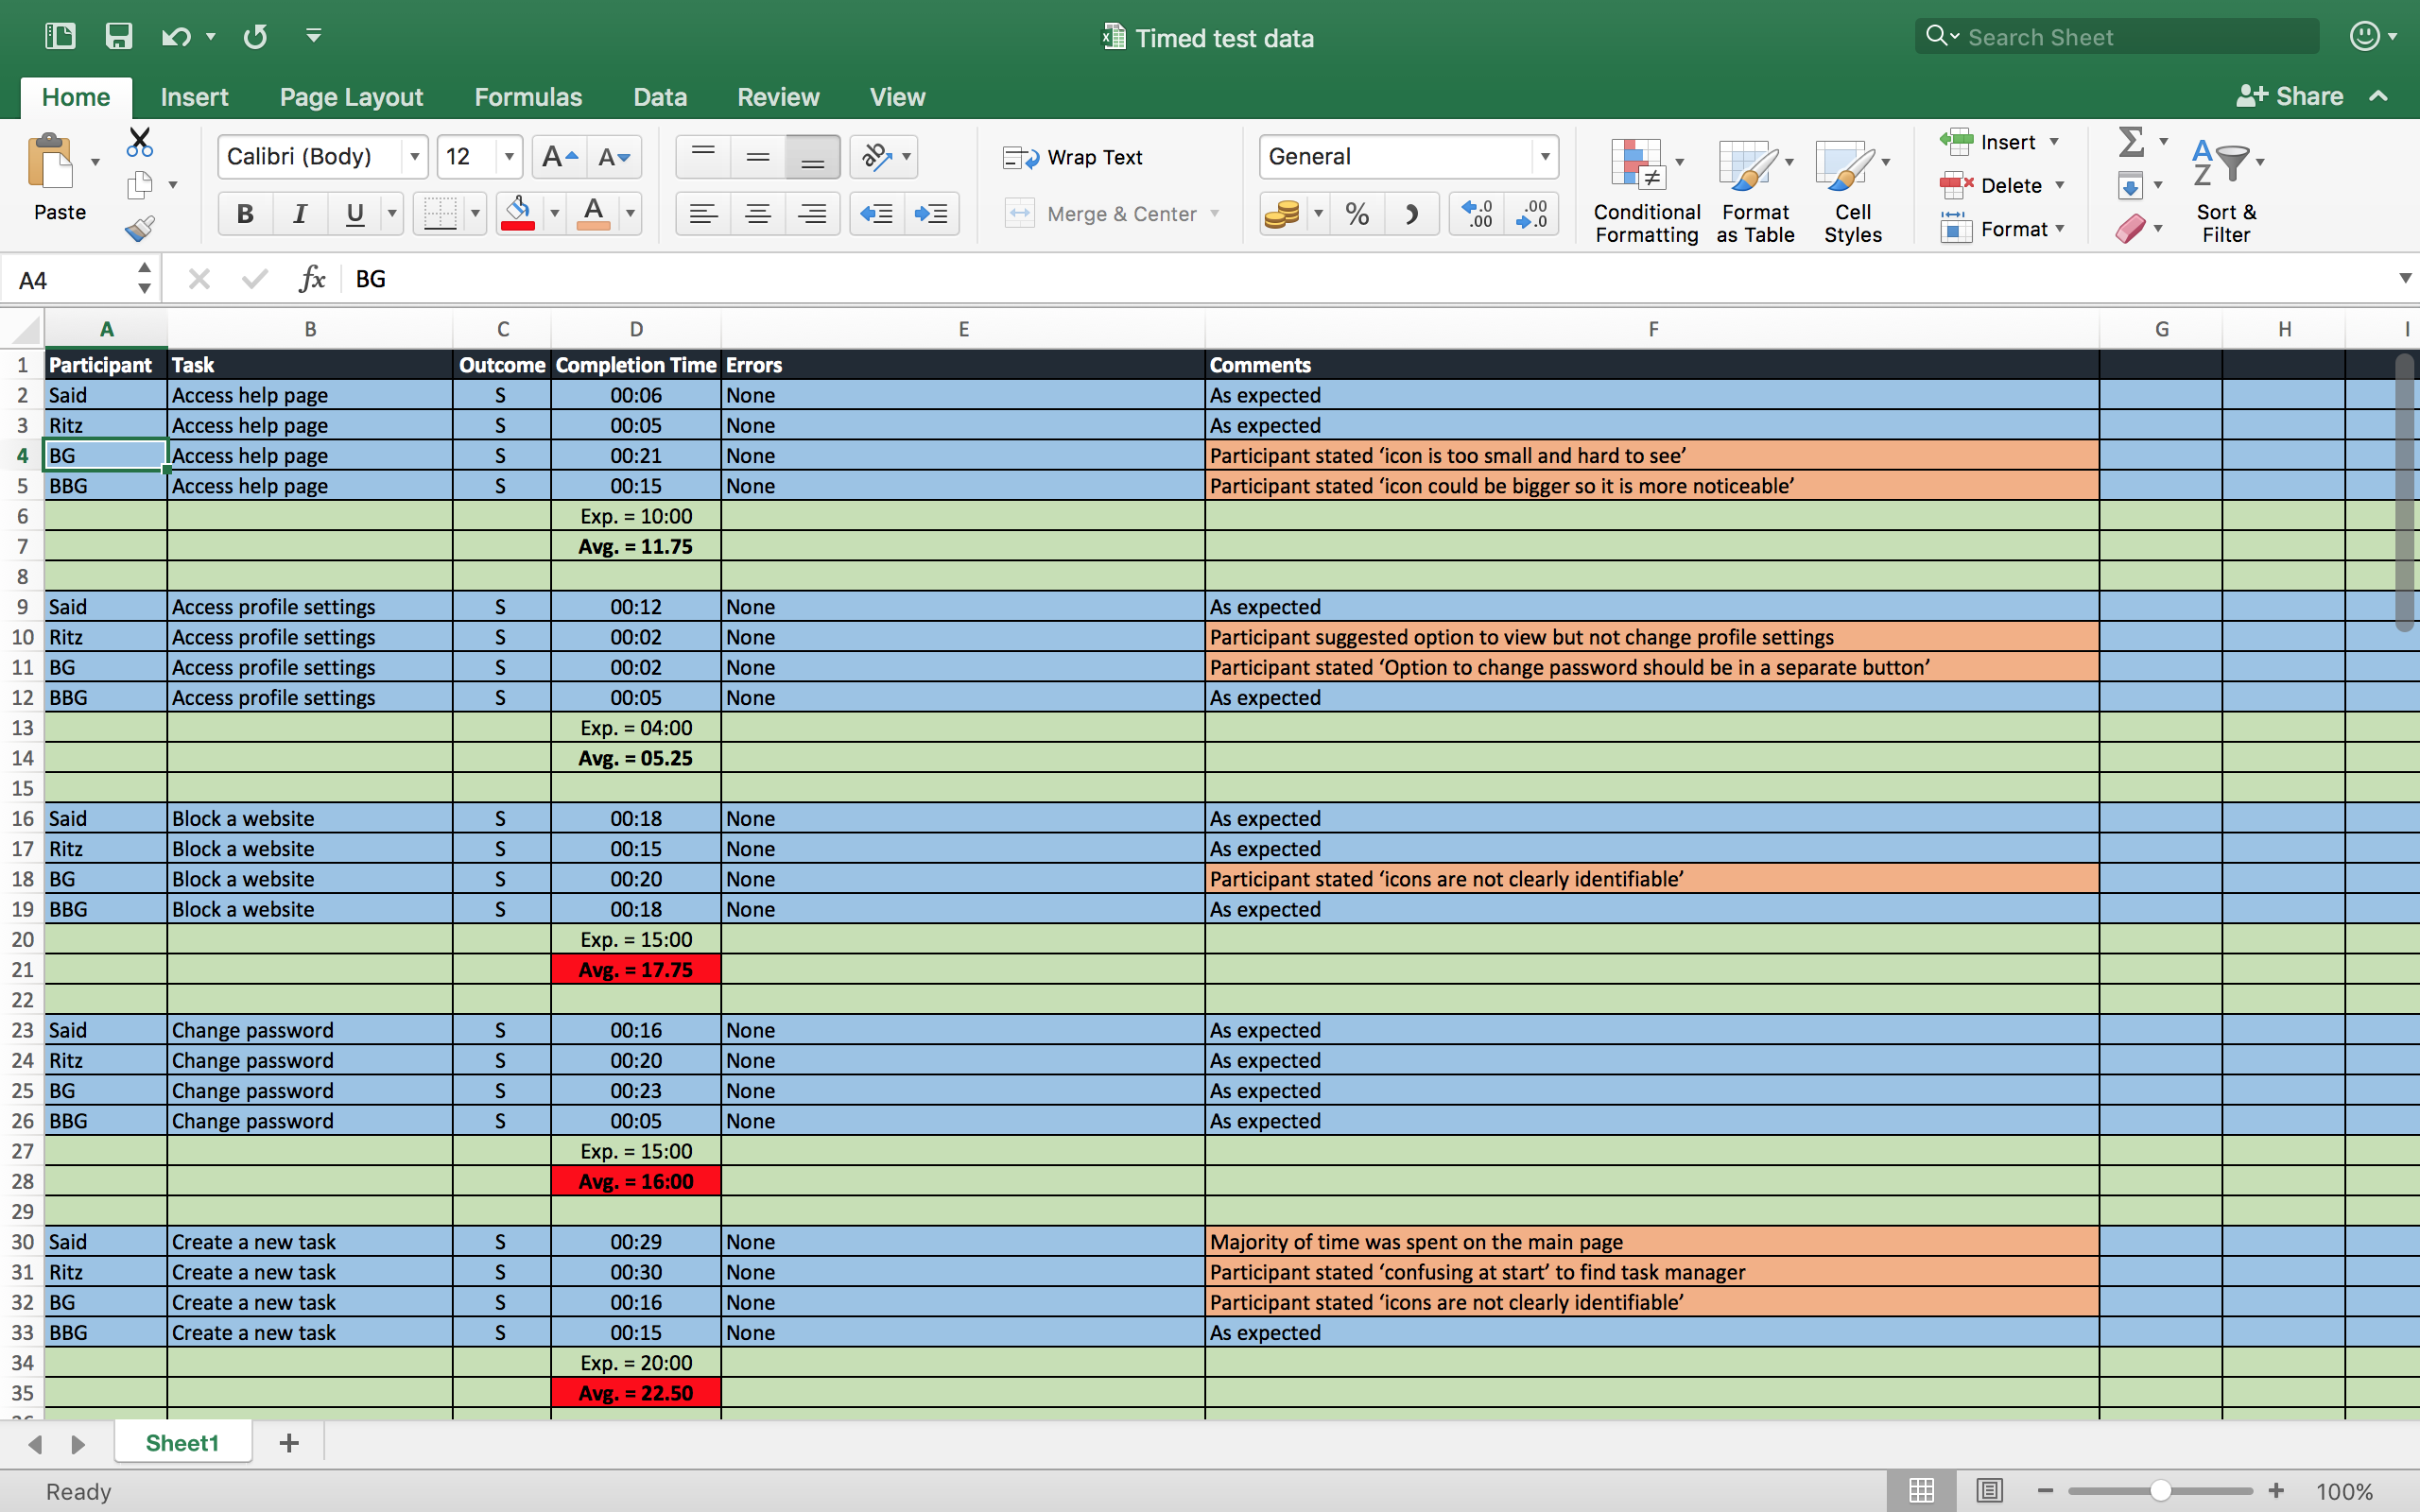
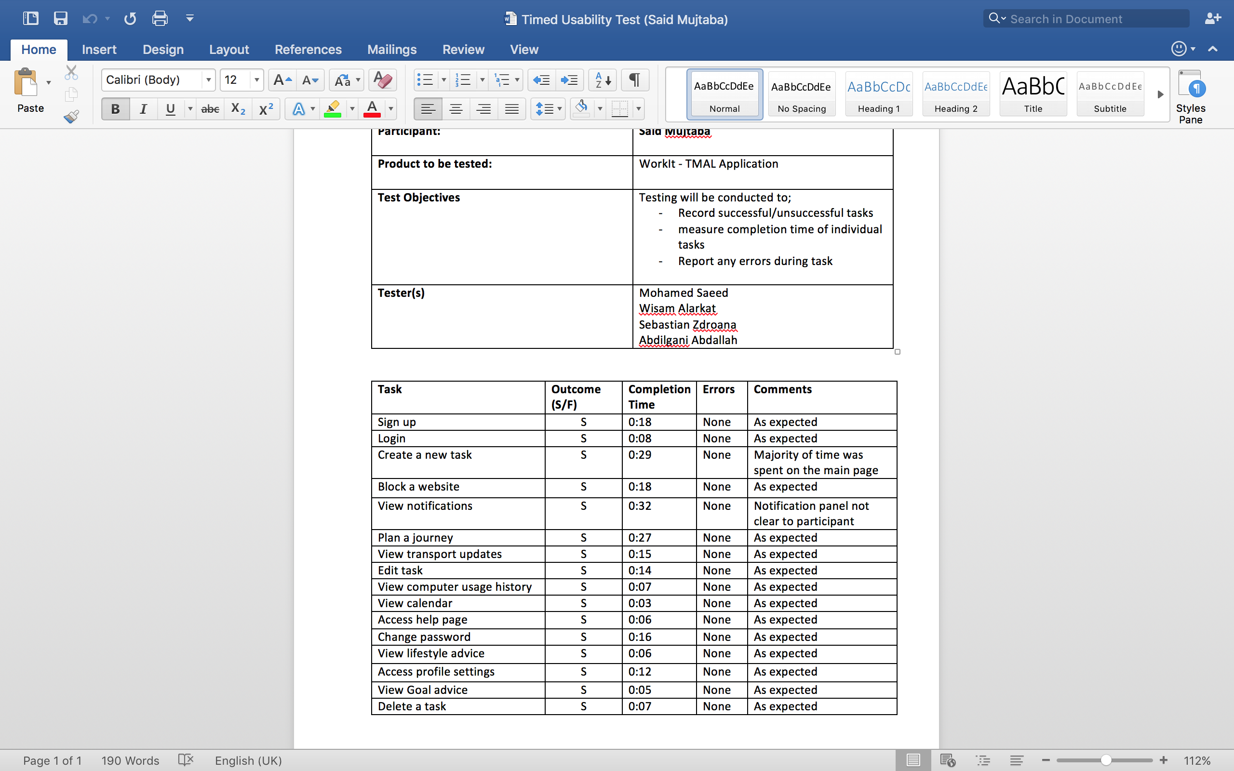
Timed Test Analysis
Notes:
So we began the timed test analysis by transferring the data into excel to help with sorting and filtering. The information gathered includes the tasks and whether participants were successful or not , the completion time, any errors that may have occurred during the test and any comments made by the test conductors.

Slide 24
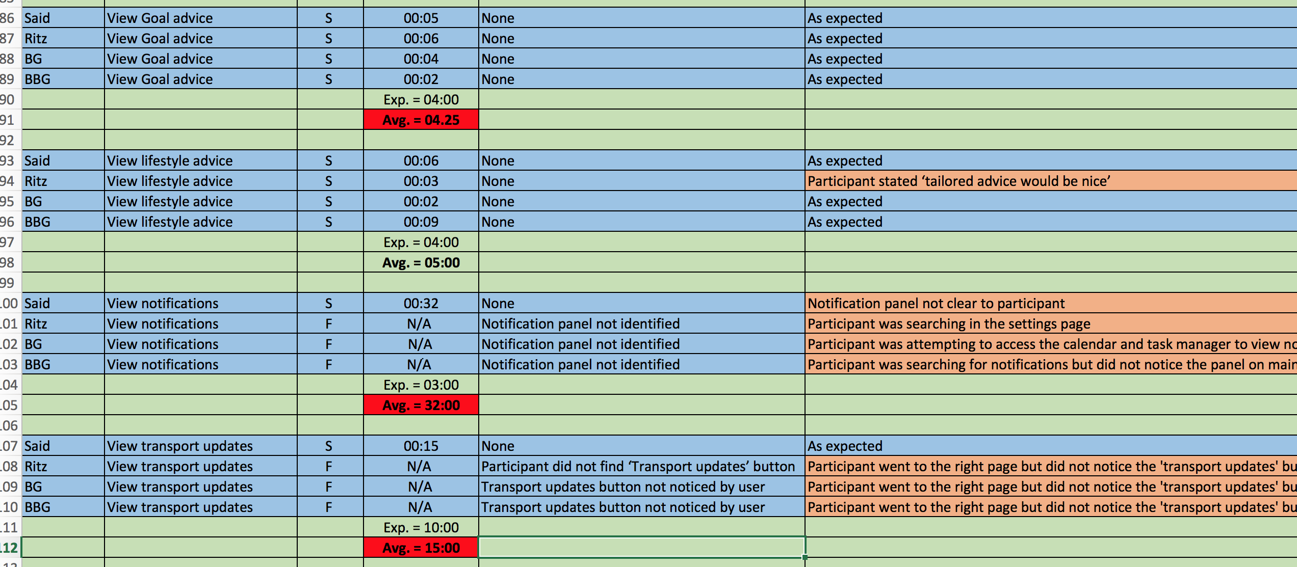
Timed Test Analysis
Average time taken
Participants failed to notice the notification bar
'Transport Updates' not noticed even though participants were on the right page
Failed tasks
Notes:
From this we were able to present the information clearly and identify the average time taken by participants. We then matched this with the expected time that we established prior to testing. We highlighted the task times which exceeded the expected time and referred to the comments for an explanation.
We were able to clearly see which tasks participants were not able to complete and in our case, there were two, ‘View notifications’ and ‘view transport updates’. We referred to the comments and found that the majority of participants failed to notice the notification panel which we originally thought was quite obvious as it was a large panel on the top of the main screen. However people were still searching in the wrong place.
We also found that even though participants selected the correct feature when asked to view ‘transport updates’, they failed to notice the button and proceeded to search elsewhere. So after discovering which tasks were problematic, we noted the issues down to identify solutions.

Slide 25

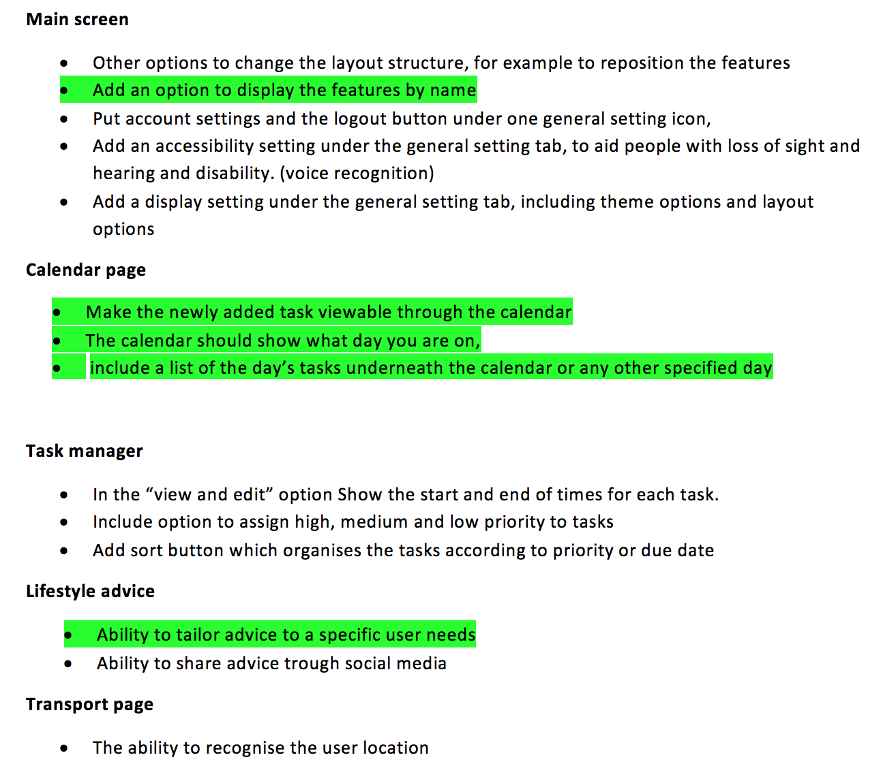
Design Improvements
Main page
label underneath icons
Notification Panel
New icon for notifications
Help Icon
Increase size of help icon
Calendar
The calendar should highlight the current day and have an option to view calendar by year, month and day
Journey planner​
Show details of journey including travel duration and arrival time​
Option to select a time to depart​
​
Lifestyle & Goal setting advice​
Tailor information to individual users
Transport updates​
Include relevant transport updates underneath journey information​
​
Settings​
Option to view but not change profile settings
Notes:
We used the findings from the tests and interviews and cross checked with our self-evaluation highlighting the improvements which were cited by the participants along with the our comments to identify our final design improvements.Our final suggestions for improvements include changes to the design of the main page as well as extending the capability of certain features.

Slide 26
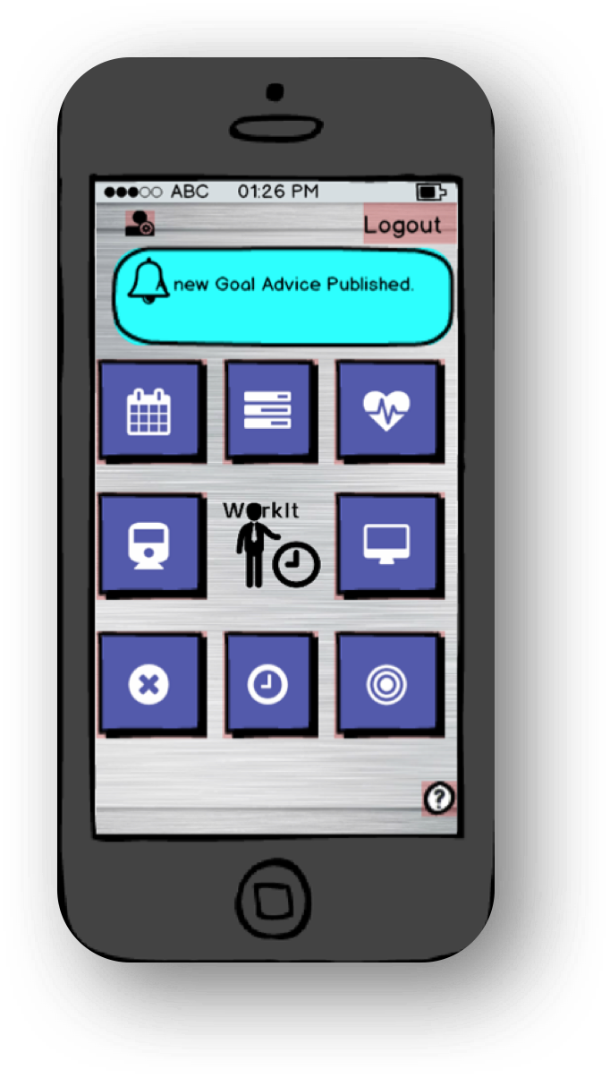
Design Improvements
Notification Panel
New icon for notifications which can be expanded when clicked
Settings
Option to view settings without changing information
Include additional layout options
“I thought it was part of the design”
“Oh, I didn’t see that
“It would be better if it shows only when notifications come in”
“There should be an option to view but not change profile settings”
Notes:
As participants didn't notice the notification panel, we suggest a new notification icon on the side of the screen which appears only when notifications come in. So just a button with a red dot which is universally known to indicate a notification. This can then be expanded once clicked.
We also decided to include the option to view settings without changing any information and include additional layouts.

Slide 27
Design Improvements
Thumbnails
label underneath icons
Help Icon
Increase size of help icon
“Can’t tell what’s what from the icons”
“It would be easier if the icons were labelled”
“icon is too small and hard to see”
”‘icon could be bigger so it is more noticeable”
Notes:
The vast majority of participants found it difficult to identify features just from the thumbnails so we proposed adding labels underneath the icons and also increasing the size of the help icon as everyone took quite long to spot it.

Slide 28
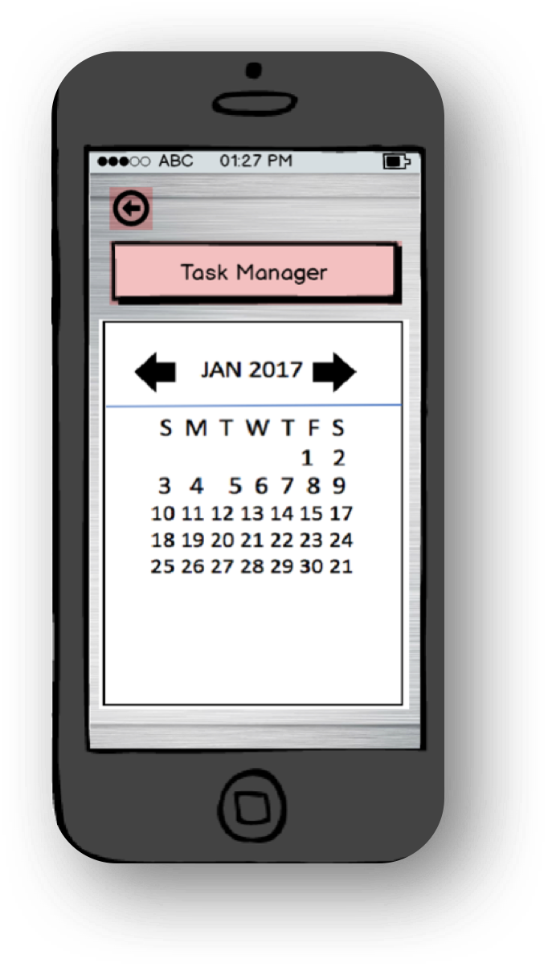
Design Improvements
Calendar
Make tasks viewable through the calendar when days are selected
The calendar should show what day you are on,
Option to view calendar by year, month and day
Feature Headings
Include headings with brief descriptions
“It’s not clear what the feature is”
“Is this the calendar or the task manager”
“I would prefer if I can change the view”
“It should highlight today somehow”
Notes:
Participants at times found it hard to figure out the purpose of some of the features. An easy solution is to include headings and brief descriptions at the top of each screen.
Changes to the calendar include highlighting the current day, giving users the option to change views and also making tasks viewable on selected days.

Slide 29
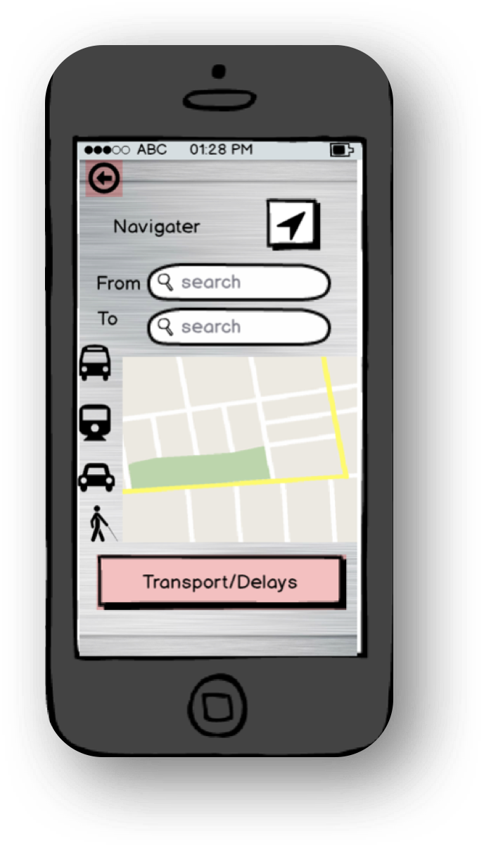
Design Improvements
Journey Planner
Show details of journey including travel duration and arrival time
Option to select a time to depart
Transport Updates
Include relevant transport updates underneath journey information
“Depart at or arrive at would be useful”
“Time frame e.g travel duration or arrival time would be better”
Notes:
Improvements to the journey planner include adding additional journey information such as duration and arrival times and as 75% of participants missed this ‘transport/delays button, we decided to remove it and include the relevant information underneath the journey details.

Slide 30
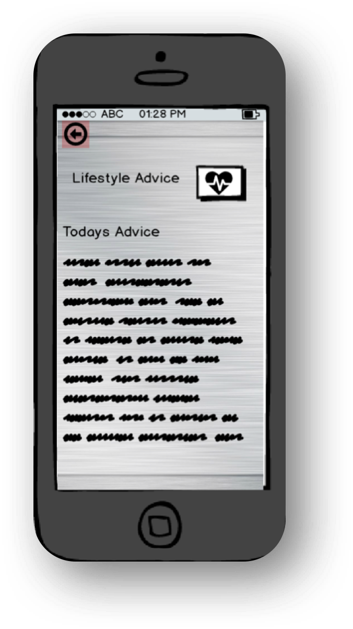
Design Improvements
Lifestyle & Goal Setting Advice
Tailor information to individual users
“tailored advice would be nice”
“It would be better if the information was relevant”
“I probably wouldn’t use it if it’s just generic information”
Notes:
And our final design improvement is to tailor the advice to individual users by asking Q’s about interests, habits, goals when the user first uses this feature.

Slide 31

Future work
Notes:
Once all of this is fixed the finalised application would be more of use to the user than the prototype is currently. This is acceptable at this current stage of the project as there is still more testing to be done. Once the prototype undergoes fixing with the newly gathered information about what the user thinks about the prototype, the application would then go onto further testing to see if there’s anything else that needs alteration or adding. Then the application can be released and that’s when the real testing starts, as right now due to the fact that this is a mock-up project where we’re gathering data from the user on a small scale, when the application is released a huge scale of users would be using the application and where bugs or impractical features are found feedback would be provided to us, much more feedback than we could ever gather now.

Slide 32

The End. Thank you for listening.

